Slide 1
Chapter 2
Instructions: Language of the Computer
Notes:
The University of Adelaide, School of Computer Science
Chapter 2 — Instructions: Language of the Computer

Slide 2
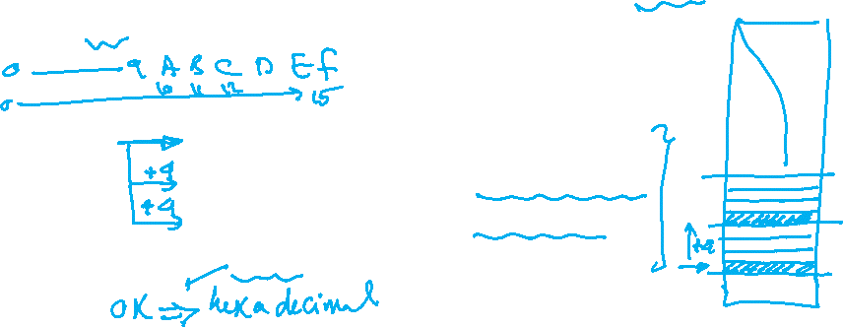
Program Counter PC
Program counter is a register stores the address of the current instruction being executed in the Text segment of the virtual memory
It is called sometimes “Instruction Pointer”
PC | Program
0x00 | sll $t1, $s3, 2
0x04 | add $t1, $t1, $s6
0x08 | lw $t0, 0($t1)
0x0C | addi $s3, $s3, 1
Chapter 2 — Instructions: Language of the Computer — <number>
Notes:
The University of Adelaide, School of Computer Science
Chapter 2 — Instructions: Language of the Computer

